Slide 1
Search Engine Design – Group 27
kk
Karen Kiernan, Li…., Bob….
8 minute presentation

Slide 2
Summary
kk
What we did
Labelled articles with a 1-5 relevance score using an LLM
Ran a variety of sample searches to compare impact on relative performance
Compared BM25 vs BM25F ranking performance on Reuters 21578 dataset
What we learned
LLM useful for labelling, BM25 generally better than BM25F(?),
(BM25F better with higher scoring relevance where more likely in title?)
….?
What we would do next
(??? Introduce BM25/BM25F with query reformulation?)

Slide 3
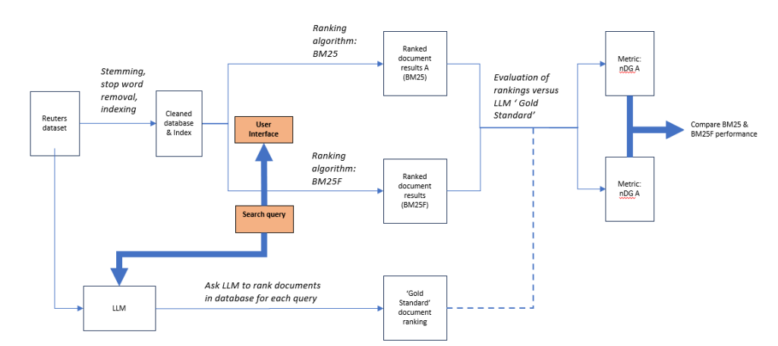
Pipeline
kk

Slide 4
Indexing method
Bob
In the presentation, the following should be made clear:
the indexing method you have used, and show some sample data
the retrieval method you have used, and be able to explain the ranking you obtain
show how everything works on the documents collection which has been provided.

Slide 5
Retrieval method
Li
In the presentation, the following should be made clear:
the indexing method you have used, and show some sample data
the retrieval method you have used, and be able to explain the ranking you obtain
show how everything works on the documents collection which has been provided.

Slide 6
Github repository
Bob
In the presentation, the following should be made clear:
the indexing method you have used, and show some sample data
the retrieval method you have used, and be able to explain the ranking you obtain
show how everything works on the documents collection which has been provided.

Slide 7
LLM relevance labelling
kk
Summarise key points here:
Method (ChatGPT, article batches, error handling, two queries per run)
Relevance scale 1-5 (Beyond Yes and No: Improving Zero-Shot LLM Rankers via Scoring Fine-Grained Relevance Labels, https://arxiv.org/abs/2310.14122)
Range of 10 queries to reflect topics vs specifics? How would this reflect recall?
Spot tested scores to sanity check results (e.g. Taylor Swift)

Slide 8
Results breakdown
Li?
Need table of dNG metric results here @ different values of n
XXXXXXXXXXXXX | XXXXXXXXXXXX | XXXXXXXXXXXXX | XXXXXXXXXXXXX | XXXXXXXXXXXXX | XXXXXXXXXXXXX
xxxxxxxxxx | xxxxxxxxxx | xxxxxxxxxx | xxxxxxxxxx | xxxxxxxxxx | xxxxxxxxxx
xxxxxxxxxx | xxxxxxxxxx | xxxxxxxxxx | xxxxxxxxxx | xxxxxxxxxx | xxxxxxxxxx
xxxxxxxxxx | xxxxxxxxxx | xxxxxxxxxx | xxxxxxxxxx | xxxxxxxxxx | xxxxxxxxxx

Slide 9
Conclusions
kk
What was better – BM25 or BM25F?
Embedding (if relevant)
Use of LLM to score relevance – pros, cons?
Follow up areas for analysis

Slide 10
Thank you

